Slide 1

Fast RCNN
Author: QChen
Date: Apr 18 2019
汇报人：第PPT

Slide 2
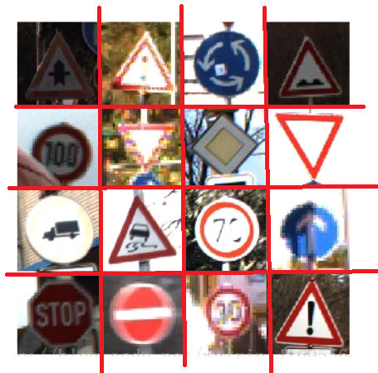
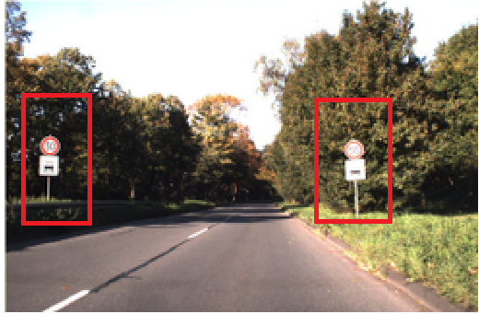
Fast R-CNN
Object Detection Model
Object Recognition
Object Detection

Slide 3
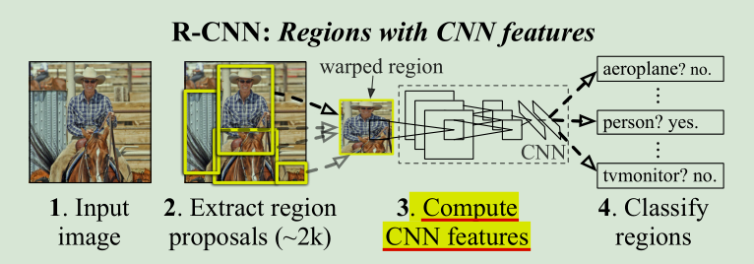
Fast R-CNN
Foresight Review
RCNN Architecture

Slide 4
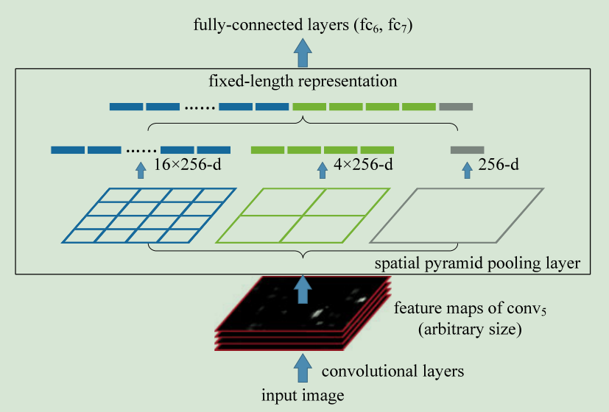
Fast R-CNN
Foresight Review
SPP Architecture

Slide 5
Fast R-CNN
Foresight Review
Model Comparison
Problem Discovery?
1. Training is a multi-stage pipeline
2. Training is expensive in space and time
SPPnet
3. Object detection is slow
—— test-time, without sharing computation

Slide 6
Fast R-CNN
Foresight Review
the fine-tuning algorithm proposed in SPPnet
cannot update the convolutional layers that precede the spatial pyramid pooling.
The way of Sampling
(RCNN)SPPnet : RoI-centric sampling
反向传播需要计算每一个RoI感受野的卷积层梯度，通常所有RoI会覆盖整个图像，
如果用RoI-centric sampling方式会由于计算too much整幅图像梯度而变得又慢又耗内存。
Fast-RCNN : Image-centric sampling

Slide 7
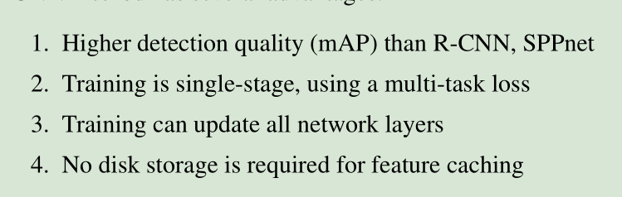
Fast R-CNN
paper: Fast R-CNN

Slide 8
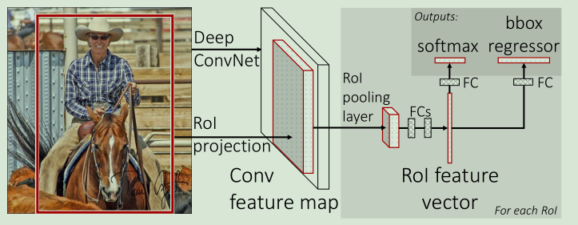
Fast R-CNN
paper: Fast R-CNN

Slide 9
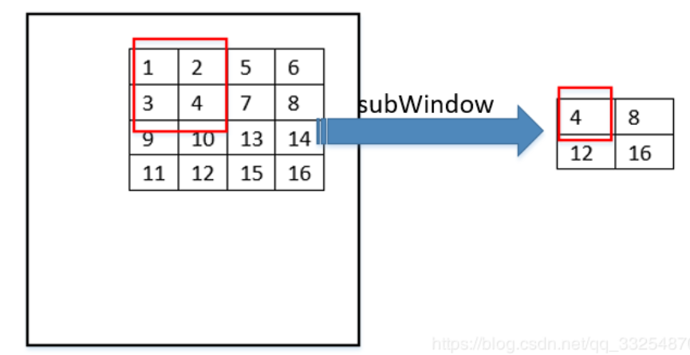
Fast R-CNN
1. The RoI Pooling layer

Slide 10
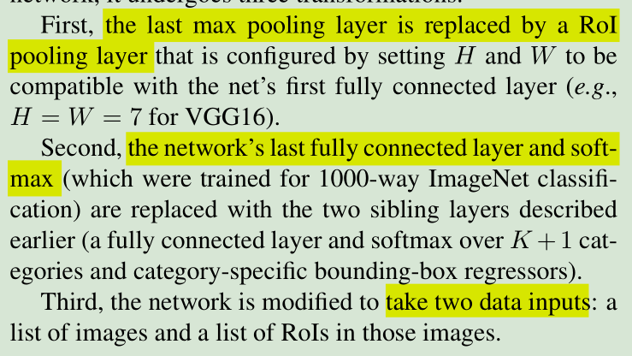
Fast R-CNN
2. Initializing from pre-trained networks

Slide 11
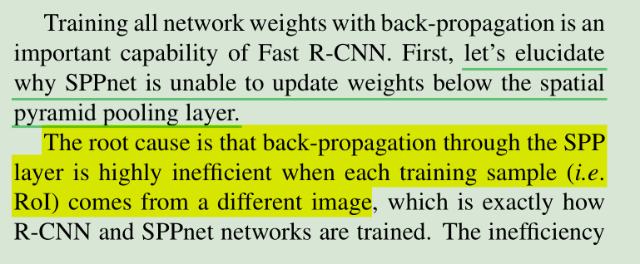
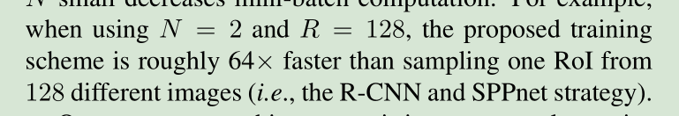
Fast R-CNN
3. Fine-tuning for detection —— hierarchical sampling

Slide 12

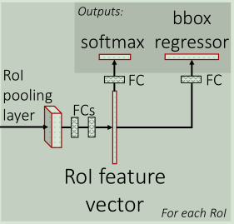
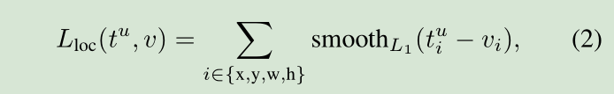
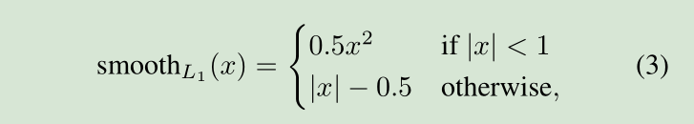

Fast R-CNN
4. Multi-task loss
u: ground-truth class u
v: ground-truth bounding-box regression target v

Slide 13
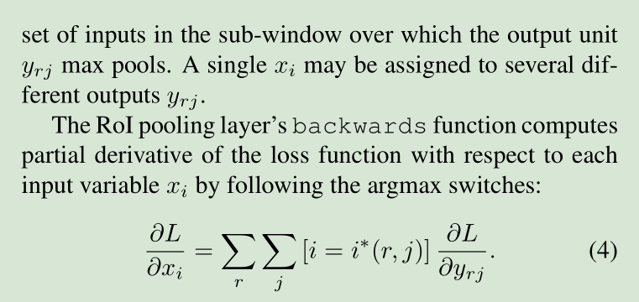
Fast R-CNN
5. Back-propagation through RoI pooling layers

Slide 14
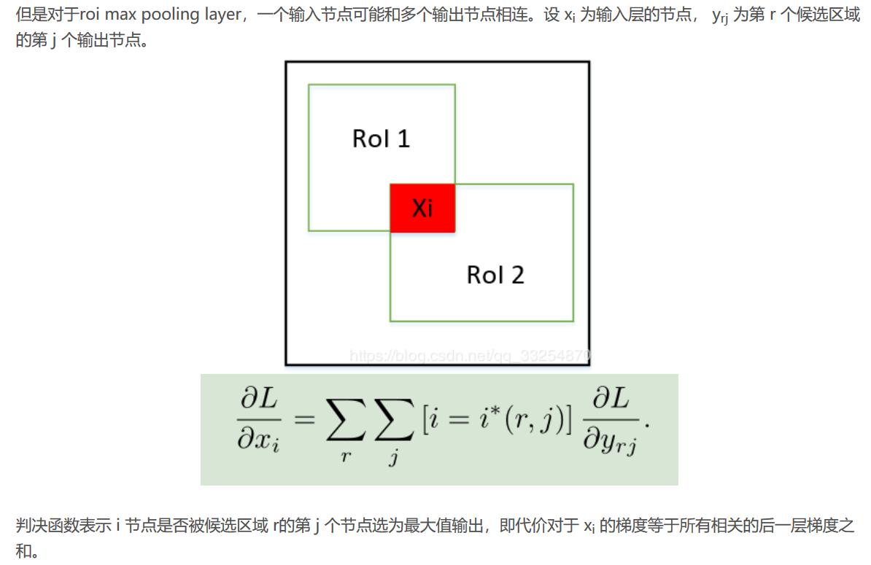


Fast R-CNN
5. Back-propagation through RoI pooling layers

Slide 15
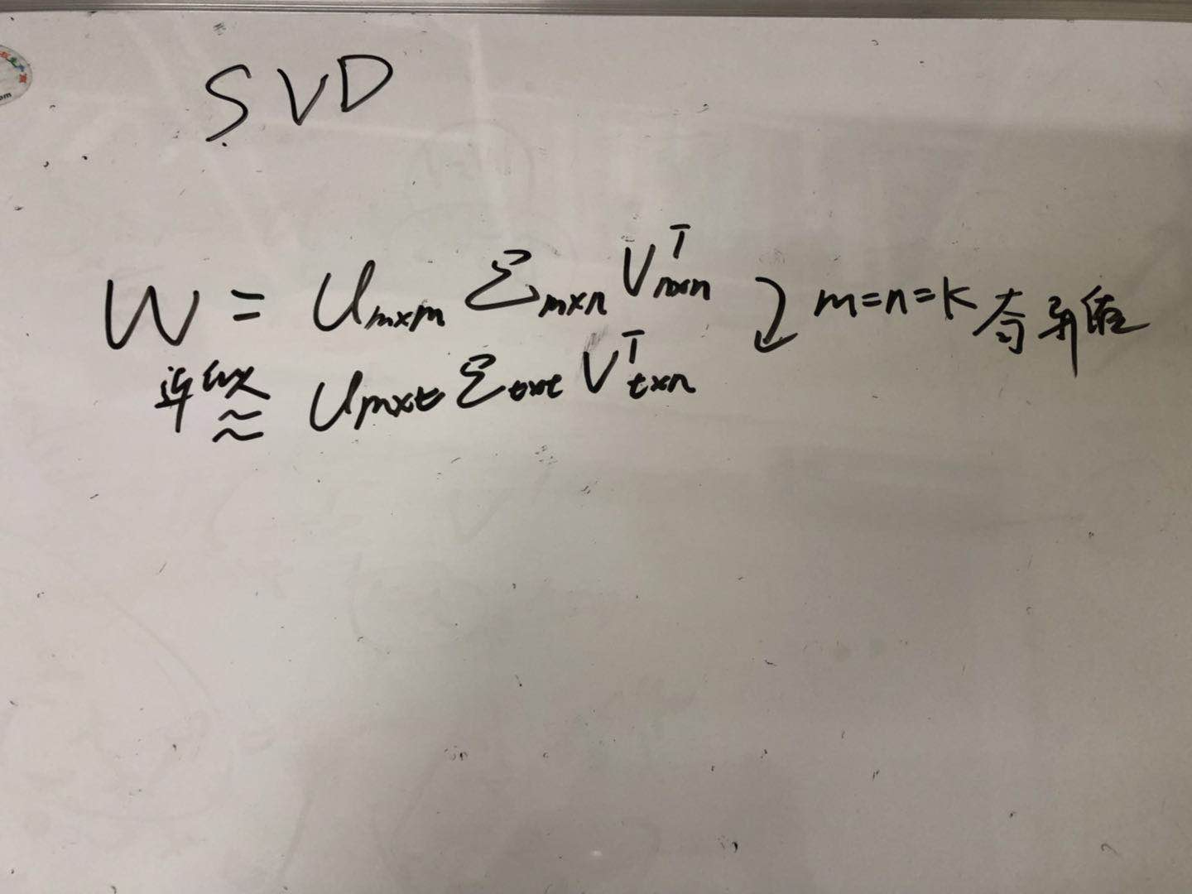
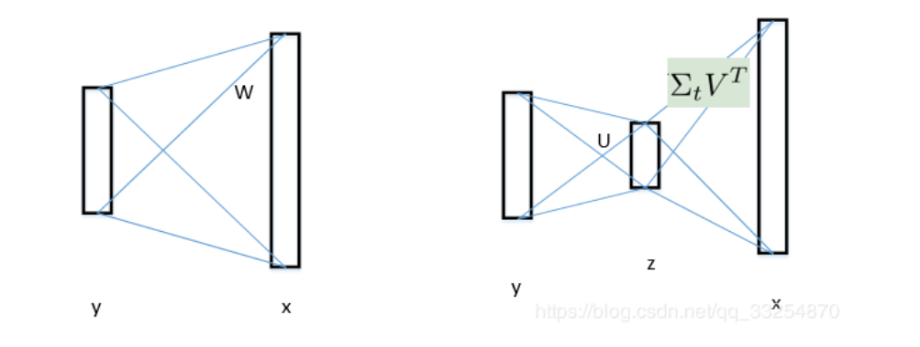
Fast R-CNN
6. Truncated SVD for faster detection

Slide 16
Fast R-CNN
Advantages
1. ROI Pooling Layer
2. Multi-task Loss
A）Softmax loss replace SVM
B）SmoothL1 Loss replace bouding-box regression
Disadvantages
1. Not end-to-end Model: SS

